Slide 1
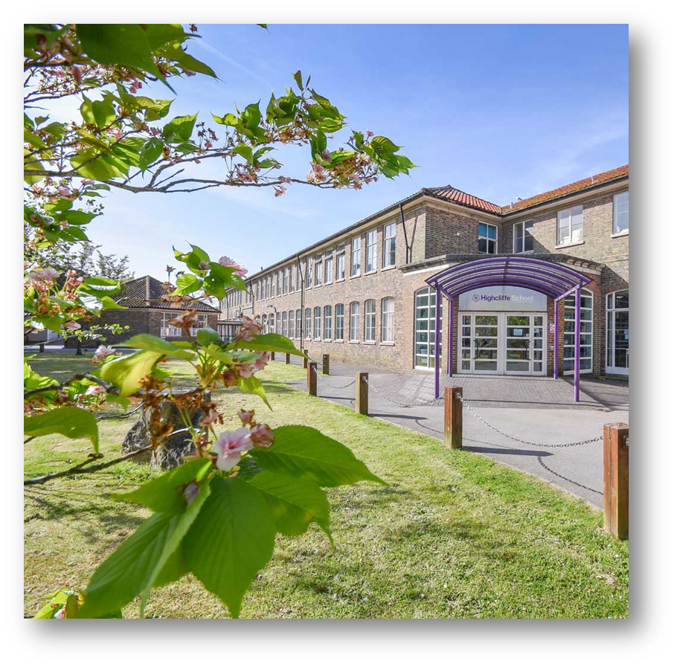
His nature is such that he has to be drawn out by kindness and encouragement but if he be treated well, and love be shown him, he will accomplish things that make the whole world wonder.
Michelangelo, describing himself as a young
art student in 1490AD
Year 10 Information Evening 2023-24

Slide 2
Welcome
Key Dates
Mock Interviews, Work Experience & Other Career Events
Requirements for success Learning Journeys and Unit Summaries
Core Subjects Information
GCSE Grading System and Progress Checks
Attendance

Slide 3
Key Dates
October
3rd Sixth Form Open Evening - school closes at 2pm
4th INSET DAY 2
November
3rd Year 10PC1 Issued
16th Year 10 Subject Evening
30th - 5th December Year 10 Berlin Trip
December
15th Christmas Concert 6.30pm
16th School closes at 12.20pm
Notes:
Open evening – an opportunity for Year 10 look at the path towards Highcliffe Sixth Form. Students have had an assembly talking about careers and pathway opportunities which will be a continuous feature throughout the year.
Progress Checks – Year 10 will have 3 this year and 2 in year 11. These will replace Continuous assessment and I will go into these in more detail near the end of the presentation
Subject Evening – a fantastic opportunity for teacher, pupils and parents to come together to evaluate the progress made so far in Year 10 and set goals to support achievement through the rest of the term into the new year

Slide 4
Key Dates
January
1st Bank Holiday
2nd Spring Term Begins
26th 10PC2 Issued
February
4th INSET DAY 3
8th Year 10/11 Oxbridge Evening (Study Centre)
13th Half Term week
20th-22nd Year 10 Mock interviews
Notes:
KS4 Oxbridge evening – This is an opportunity for students to look at the potential pathway to Oxford and Cambridge University and what the requirements would be to gain access to these prestigious institutions
Mock interviews – Local business leaders come into school and students will have the opportunity to experience what it will be like to go through an interview in latter life. Feedback from these interviews is given. Mr Hallam will talk more about this shortly.

Slide 5
Key Dates
March
3rd National Careers Week
31st End of Spring Term - School Closes 12.20pm
31st Year 10 Pila Trip Leaves
April
15th Summer Term Begins
Year 10 Art Internal Exams
Year 10 DofE Silver Practice
Notes:
Start of mock exams for art – other subjects will follow later in the school year. Through the KS4 journey they will sit 3 sets of mock examinations to put them in the best position to sit the summer exams of 2025

Slide 6
Key Dates
May
9th Year 10 PC3 Issued
Year 10 DofE Silver Assessed
25th Half Term week
June
3rd INSET DAY
Year 10 Drama Full Day Tech / Dress Rehearsal Ex1 & Ex4
Year 10 Drama Evening Performance Exam Ex1 & Ex4
24th School Diversity Week
21st Year 10 Internal Exams begin
July
1st Year 10 Internal Exams end
8th – 19th Year 10 Work Experience
23rd End of Summer Term - School closes 12.20pm
Notes:
Internal examinations through June so students will experience the exam environment which will follow at the end of the KS4 process. These examinations will be a fantastic insight as to where students are academically at the end of year 10. These results will be given early in Year 11 with the first progress check to follow not long after.
Work experience – an amazing opportunity and experience for young students which will inform them for the potential career pathways that lie a head – Again Mr Hallam will talk more about this shortly.

Slide 7
Every lesson at Highcliffe School we have the school’s core principles at heart;
Respectful
Responsible
Purposeful
Notes:
Greet students at the door
Start activities
Retrieval practice modelled and used in class to support student retain information
Variety of questioning to check understanding
Sustained intense concentration in class – an opportunity to focus in every lesson and apply the content or skill being taught
Feedback – On class work and assessments which students are expected to interact with and in some cases re-do work to make sure the best work in line with ability is achieved

Slide 9
His nature is such that he has to be drawn out by kindness and encouragement but if he be treated well, and love be shown him, he will accomplish things that make the whole world wonder.
Michelangelo, describing himself as a young
art student in 1490AD
Year 10 Information Evening
Careers Input: Mr Hallam

Slide 10
Careers Input Timeline
Dates | Events
28/09/23 | Careers Fair (Biannual)
9/10/23 | Work Experience Launch to students in assembly
10/23 – 06/24 | Careers Advisor meetings (individual)
01/24 – 02/24 | Mock Interviews
15/07/24 - 19/07/24 | Year 10 Work Experience – 1 week
23/07/24 | Work Experience debrief

Slide 11
Work Experience
15th July 2023 – 19th July 2023

Slide 12
Date | Timeline
9th October 2023 | Launch assembly
20th October 2023 | Tutors check application has been made and initial placements
11th December 2023 | Tutors to ensure students have a draft placement
12th January 2024 | Students chased late applications – lunchtime support
23rd February 2024 | SHM to ensure all external placements have had vetting requested
Easter 2024 | Students to have placements in place, including confirmation from employer
Summer term | Lunch time supports for students with placements, that have been cancelled
15th July 2024 – 19th July 2024 | Year 10 Work experience
21st July 2024 | Student debrief – In school

Slide 13
Why Work Experience?

Slide 14
Why Work Experience?
Develop a range of skills and knowledge you might not otherwise have the chance to explore.
It enhances your understanding of the world of work.
Insight into different sectors and careers.
Aids the development of ‘employability skills’.
The opportunity to ‘try out’ an area of potential interest.
Valuable experience to add to a cv or personal statement.
Many employers are happy to provide a reference.
An opportunity to impress local business people.
Start building a network of business contacts.

Slide 15
The Placement
Ideally this will be matched to the individuals career aspirations.
The STUDENT should be pro-active in their search for a work placement.

Slide 16
How we will help you prepare for work experience
We will provide all the information via My Highcliffe, including formal letter templates.
Access to the database http://dorset.learnaboutwork.org
Provide the opportunity to have a ‘mock’ interview.
Prepare formal letters of application and a CV.
Careers guidance interviews.

Slide 17
What your child will need to do
Read through the placement details with parents
Make sure they can get to the placement as travel expenses will not be covered.
Get in touch with the employer to ask if they will be able to take them for work experience.
Some employers will ask for a formal letter and possibly an interview. Others will only want the agreement forms.

Slide 18
Mock Interviews
January 2024 – February 2024

Slide 19
External professional
Chamber of Commerce
Local industry staff
Highcliffe Rotary Club
20 min long
Student portfolio
CV
Personal statement
Excellent work
Certificates
What is a Mock Interview

Slide 20
Things for students to consider
First impressions count
quality of voice, grammar and confidence
Showcase achievements

Slide 21
Careers advisor meeting
All students in year group
30 min long
Level 6 qualified independent careers advisor
University, Apprenticeship and world of work advice and guidance

Slide 22
“
His nature is such that he has to be drawn out by kindness and encouragement but if he be treated well, and love be shown him, he will accomplish things that make the whole world wonder.
Michelangelo, describing himself as a young
art student in 1490AD
”
Year 10 Information Evening Hannah Stedmon – SLT - Learning Journeys and Unit Summaries

Slide 23
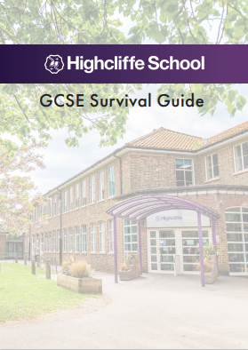
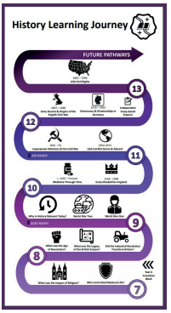
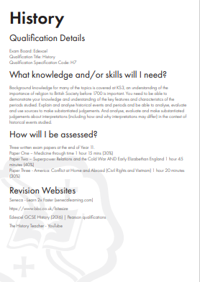
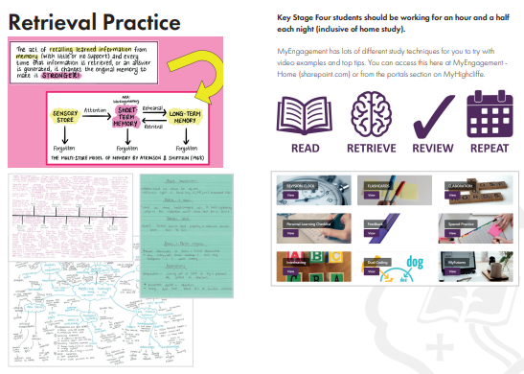

Slide 24
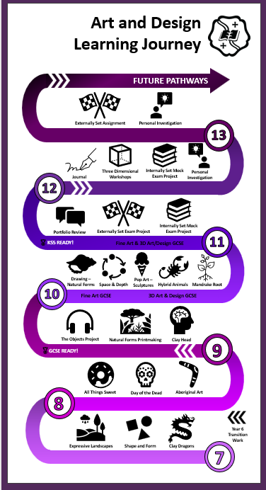
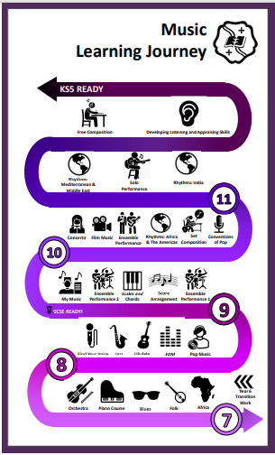
YOUR Learning Journey

Slide 25
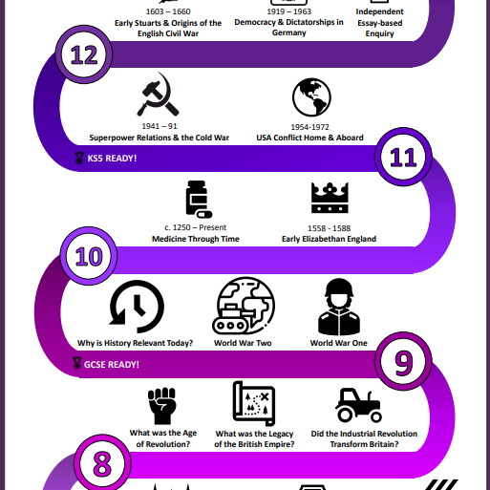
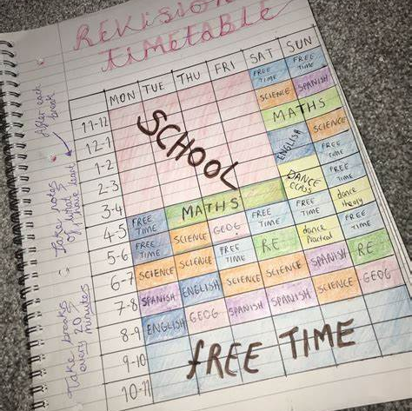
Revision preparation
What topics have I studied?
What do I need to know?
What will I need to know?

Slide 26
Unit Summaries
What will we learn?
Why this? Why Now?
Key Vocabulary
Wider Study
Assessment

Slide 27
“
His nature is such that he has to be drawn out by kindness and encouragement but if he be treated well, and love be shown him, he will accomplish things that make the whole world wonder.
Michelangelo, describing himself as a young
art student in 1490AD
”
Year 10 English Mr James

Slide 28
AQA GCSE ENGLISH
ENGLISH LANGUAGE (8700)
ENGLISH LITERATURE (8702)
*SPOKEN LANGUAGE AWARD

Slide 29
AQA GCSE ENGLISH
ENGLISH LANGUAGE (8700)

Slide 30
AQA GCSE ENGLISH LANGUAGE
ENGLISH LANGUAGE (8700)
Speaking & Listening
Individual Presentation
Paper 1: Explorations in Creative Reading & Writing (50%) – 1hr 45 minutes
Reading Literary Fiction
Descriptive or Narrative Writing
Paper 2: Writers’ Viewpoints and Perspectives (50%) – 1 hr 45 minutes
Reading Non-Fiction & Literary Non-Fiction
Writing to Present a Viewpoint

Slide 32
Formal Mock Examinations
December mock series:
Paper 2 (full paper)
March mock series:
Paper 1 (full paper)

Slide 33
PAPER 1: OVERVIEW
QUESTION | MARKS | TIME | STUDENT KNOWLEDGE & SKILLS
 |  | 15 mins | READING the QUESTIONS and TEXTS closely
1 | 4 | 5 mins | FINDING and LISTING four key pieces of INFORMATION
2 | 8 | 10 mins | ANALYSING how and why the writer uses LANGUAGE & LANGUAGE TECHNIQUES
3 | 8 | 10 mins | ANALYSING how and why the writer uses STRUCTURE
4 | 20 | 20 mins | PRESENTING a clear OPINION of the writer’s METHODS
5 | 40 | 45 mins | WRITING a DESCRIPTIVE or NARRATIVE piece which: communicates clearly organises information includes a range of vocabulary & sentences demonstrates accurate spelling and punctuation

Slide 34
PAPER 2: OVERVIEW
QUESTION | MARKS | TIME | STUDENT KNOWLEDGE & SKILLS
 |  | 15 mins | READING the QUESTIONS and TEXTS closely
1 | 4 | 5 mins | IDENTIFYING four true statements
2 | 8 | 8 mins | SUMMARISING and SYNTHESISING the differences between texts using EVIDENCE and INFERENCE
3 | 12 | 12 mins | ANALYSING how and why the writer uses LANGUAGE and LANGUAGE TECHNIQUES
4 | 16 | 20 mins | COMPARING the writer’s ATTITUDES and METHODS
5 | 40 | 45 mins | WRITING a OPINION essay which: communicates clearly organises information includes a range of vocabulary & sentences demonstrates accurate spelling and punctuation

Slide 35
TOP TIPS
Answer all the QUESTIONS.
Spend the correct length of TIME on each question.
Look for KEYWORDS in the questions.
Write about the SPECIFIED SECTIONS of the texts.
Organise your answers into PARAGRAPHS.
Provide three DEVELOPED PARAGRAPHS in Q2, Q3 & Q4.
Use SQUID/WHAT HOW WHY to STRUCTURE your responses to Q2, Q3 & Q4.
Meet the WRITING BRIEF in Q5.
Use the full range of PUNCTUATION (! ? - : ;).
RE-READ your Q5 response to check for clarity and accuracy.

Slide 36
LANGUAGE SUPPORT & REVISION
Use support materials to help consolidate, clarify and extend your understanding: books like the CGP and York Notes guides are helpful, as are websites like BBC Bitesize, also videos such as those on Mr Bruff’s YouTube channel.
Keep up your general reading: discuss what you have read e.g. summarise the content, attitudes and perspectives; consider how the writer made you feel and why.
Practise writing: even small sections are helpful. Think about how to make your writing attention-grabbing and memorable, particularly the opening.
Keep and learn a vocabulary list: you can include key terminology from lessons, but also interesting words you come across which you could use in your own writing.
Identify areas of SPaG you find difficult and practise to get them right. There are lots of books and online resources to help with spelling, punctuation and grammar: the BBC Skillswise website is very straightforward to understand.
Revisit any previous exam papers you have completed or look at those on the AQA website.
Drop-in support sessions in school.

Slide 37
AQA GCSE ENGLISH
ENGLISH LITERATURE (8702)

Slide 38
AQA GCSE ENGLISH LITERATURE
ENGLISH LITERATURE (8702) –
Paper 1: Shakespeare and the 19th Century Novel (40%) – 1 hr 45 minutes
Shakespeare Play: Romeo & Juliet or Macbeth or Julius Caesar
19th Century Novel: A Christmas Carol
Paper 2: Modern Texts & Poetry (60%) – 2 hr 15 minutes
Modern Play: An Inspector Calls
Poetry Collection – Power & Conflict
Unseen Poems

Slide 40
Formal Mock Examinations
December mock series:
Paper 1 (Shakespeare/19th Century)
March mock series:
Paper 2 (AIC/Power Poetry/Unseen Poetry)

Slide 41
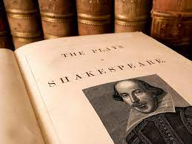
PAPER 1: OVERVIEW
CLOSED BOOK EXAMS – NO TEXTS
SECTION A: Romeo & Juliet or Macbeth or Julius Caesar 55 minutes. An extract to whole text question. Marked /30 plus 4 marks for SPaG.
SECTION B: A Christmas Carol 50 minutes. An extract to whole text question. Marked /30.

Slide 42
PAPER 2: OVERVIEW
CLOSED BOOK EXAMS – NO TEXTS
SECTION A: An Inspector Calls 45 minutes. A whole text question. Marked / 30 plus 4 marks for SPaG.
SECTION B: Power & Conflict Poetry 45 minutes. Comparison question: 1 printed poem and 1 of choice. with another printed poem. Marked /8Marked /30
SECTION C: Unseen Poetry 45 minutes. Part 1: Responding to a printed poem. Marked /24 Part 2: Comparing

Slide 43
LITERATURE SUPPORT & REVISION
Read your texts over again. It can be helpful to have your own copy in which to make notes. Make sure you understand the plot, characters, themes and context.
Make a list of key quotes and learn them.
Use support materials to help consolidate, clarify and extend your understanding: books like the CGP and York Notes guides are helpful, as are websites like No Fear Shakespeare and BBC Bitesize, also videos such as those on Mr Bruff’s YouTube channel.
Use the PixLit app for revision, but bear in mind that while it is a fantastic resource for helping students to remember key quotations and themes, some features are just going to give one singular interpretation of a quotation. This doesn't necessarily mean your interpretation is invalid, but may just not be the one PixLit had in mind.
Lectures from Massolit
Seneca quizzes
Keep and learn a vocabulary list: key terminology from lessons.
Revisit any previous exam papers you have completed or look at those on the AQA website.
Drop-in sessions in school.

Slide 44
“
His nature is such that he has to be drawn out by kindness and encouragement but if he be treated well, and love be shown him, he will accomplish things that make the whole world wonder.
Michelangelo, describing himself as a young
art student in 1490AD
”
Year 10 Information Evening Mathematics Mr Cooper

Slide 45
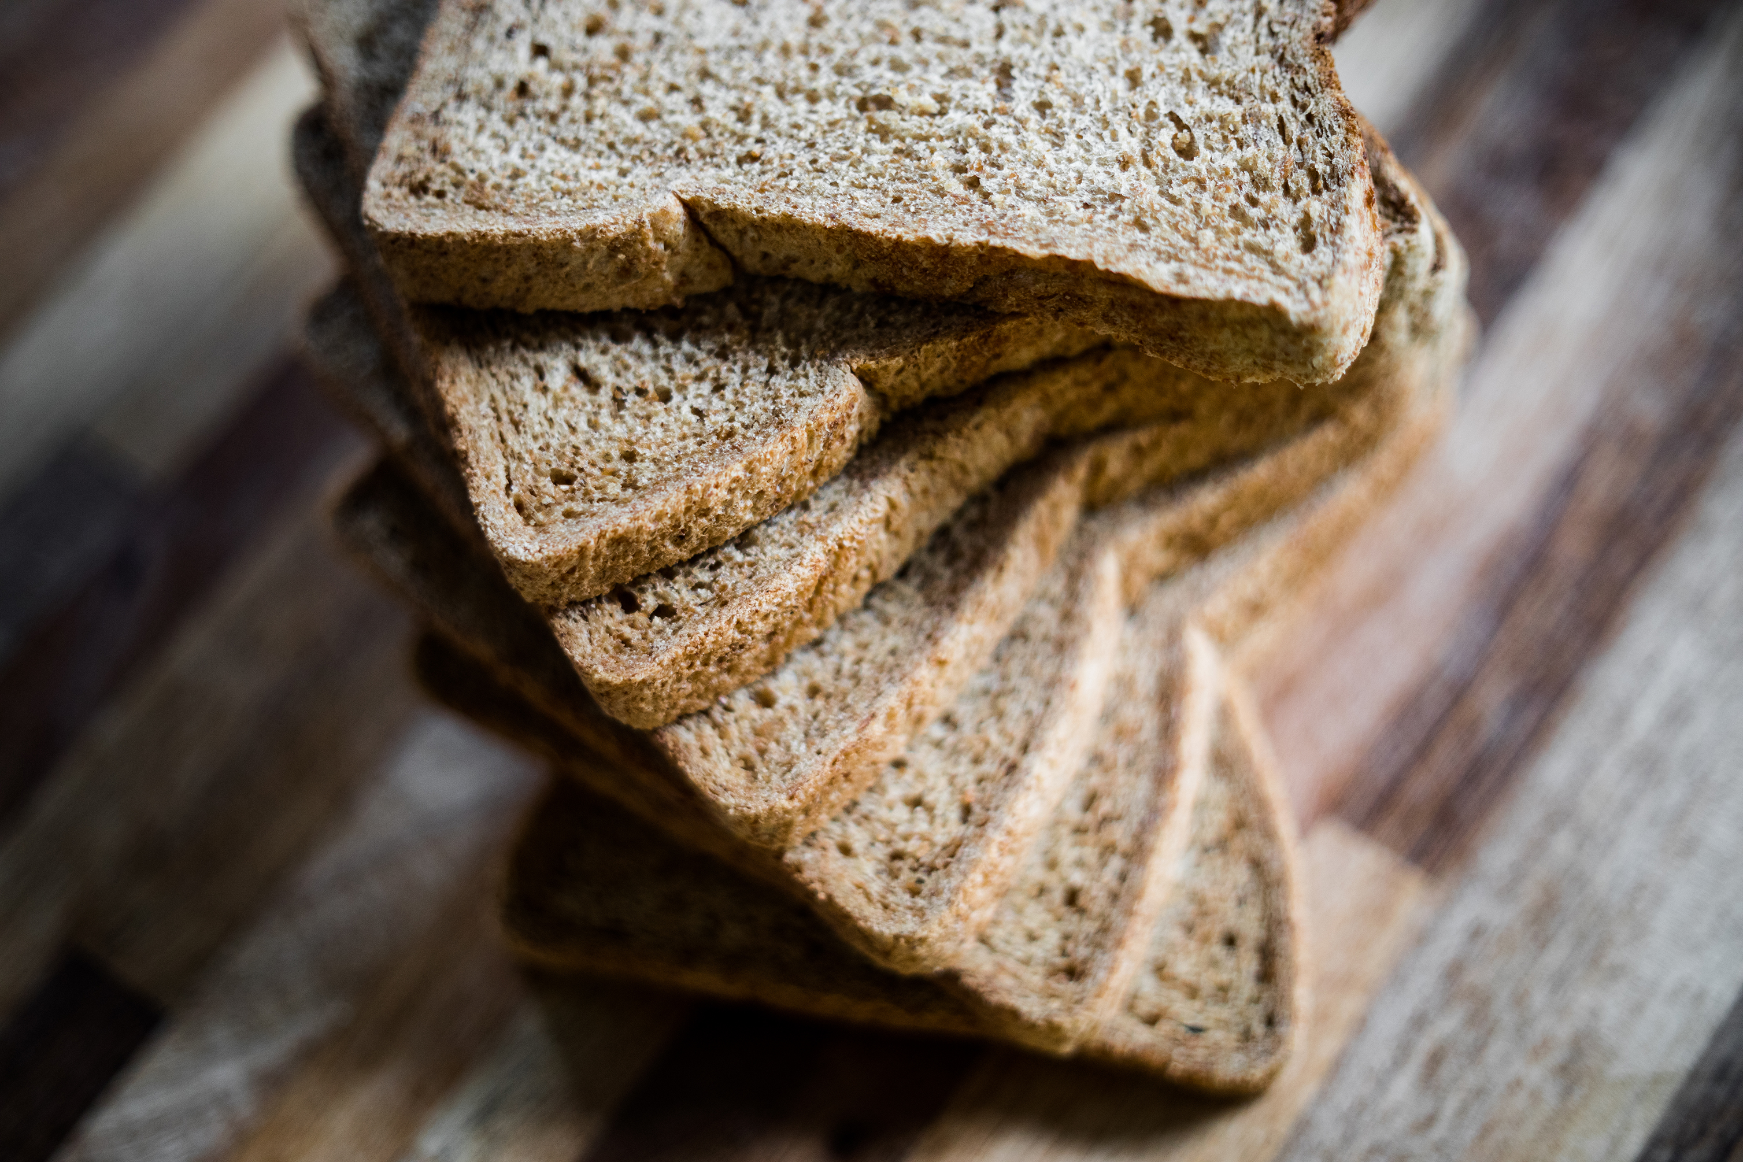
How many slices of bread does the average British person throw away in a lifetime?

Slide 46
DEVELOPING A POSITIVE ATTITUDE TOWARDS
MATHS IS VITAL
This sort of question can often be asked at an interview to see how applicants deal with what seems to be an impossible question to answer.
Maths develops the skills needed in order to be able to break down questions such as this into smaller questions you know something about.
This directly relates to GCSE mathematics.
At the core of studying mathematics isn’t necessarily the content, it is a subject that develops critical thinking, creativity and the ability to reason, problem solve and communicate your ideas.
These are key skills employers are looking for regardless of the career type.

Slide 47
GRADES ARE IMPORTANT TOO
Last year around 73% of students sitting GCSE mathematics gained a grade 4 or above.
Students achieving a grade 5 or above drops to around 53% (the grade you need to enter Highcliffe Sixth Form)
Each grade increase drops by around 10-15%, each grade bring you closer to the front of the queue.

Slide 48
EDEXCEL GCSE (9-1) MATHEMATICS OUTLINE
There are 6 strands assessed across mathematics at GCSE:
Number
Algebra
Ratio, proportion and rates of change
Geometry and measures
Probability
Statistics
Two tiers: Foundation and Higher (there is crossover content but also content that appears on the Higher tier that does not appear on Foundation)
Students will take assessments in either Higher or Foundation tier.
Foundation tier: grades 1 to 5
Higher tier: grades 4 to 9 (grade 3 allowed). To be entered into the Higher tier a student should be aiming to gain a grade 6 or above.

Slide 49
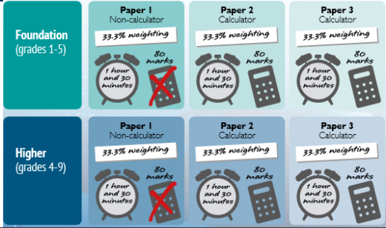
EDEXCEL GCSE (9-1) MATHEMATICS EXAM STRUCTURE

Slide 50
ASSESSMENT AND LESSONS
Students will sit two full sets of examination papers across the Autumn and Spring terms. In school examination window’s will help to facilitate these mock examinations.
Smaller topic based assessments, retrieval practice and regular homestudy tasks will be used to continually monitor progress.
Content will continue to be covered over the Autumn and early Spring term.
Revision work starts now.

Slide 51
STEPS TO SUCCESS
The best way to learn maths is to do maths, little and often is most effective.
Make the best use of lesson time.
Ensure you know how to use your calculator, make sure it is a scientific calculator (we recommend a Casio fx-83GT CW or fx-85GT CW, these are the updated calculators from the Casio fx-83GTX or fx-85GTX)
Complete all home study set to the best standard, aim for 100% at hand in.
Regular practice of the fundamentals, arithmetic, algebraic manipulation, learning key vocabulary and formulae not given in the exam.
Ask for help, don’t wait until its too late.

Slide 52
RESOURCES
Revision guides – available through WisePay - £2.70
Dr Frost Maths
Corbett Maths
Maths Genie

Slide 53
“
His nature is such that he has to be drawn out by kindness and encouragement but if he be treated well, and love be shown him, he will accomplish things that make the whole world wonder.
Michelangelo, describing himself as a young
art student in 1490AD
”
Year 10 Information Evening Head of Physics Mrs Green

Slide 54
SCIENCE GCSES
9 -1 grades
All linear examinations
6 exams, 2 for each science subject
No coursework, students practical knowledge tested in examinations (15% of questions)
Emphasis on;
the application of science knowledge
analysing, interpreting and evaluating skills
maths skills

Slide 55
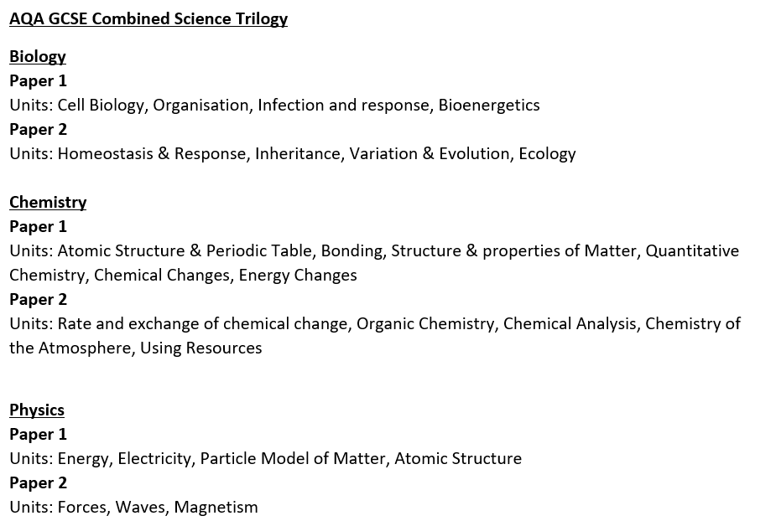
AQA COMBINED SCIENCE TRILOGY
2 examinations for each subject, each 1 hour 15 minutes in duration and worth 16.7% of course
2 GCSE grades awarded

Slide 56
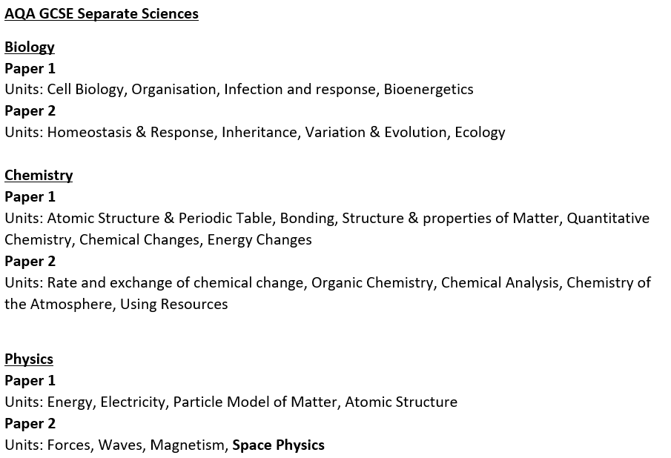
AQA Separate Sciences; Biology, Chemistry & Physics
2 examinations for each subject, each 1 hour 45 minutes in duration and worth 50% of course
3 GCSE grades awarded, 1 for each subject

Slide 57
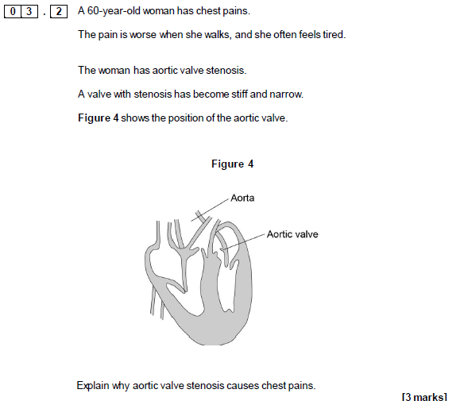
STYLE OF EXAM QUESTIONS

Slide 58
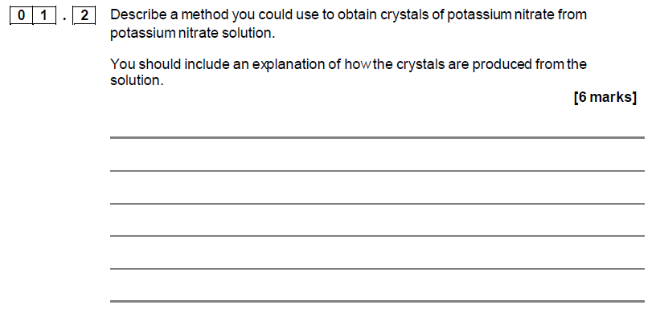
STYLE OF EXAM QUESTIONS

Slide 59
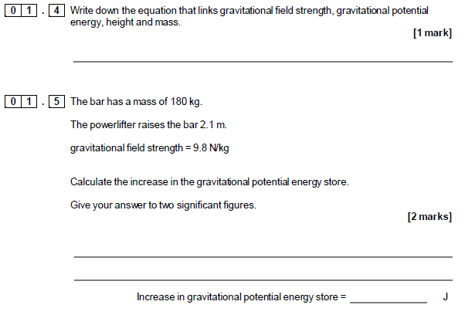
STYLE OF EXAM QS

Slide 60
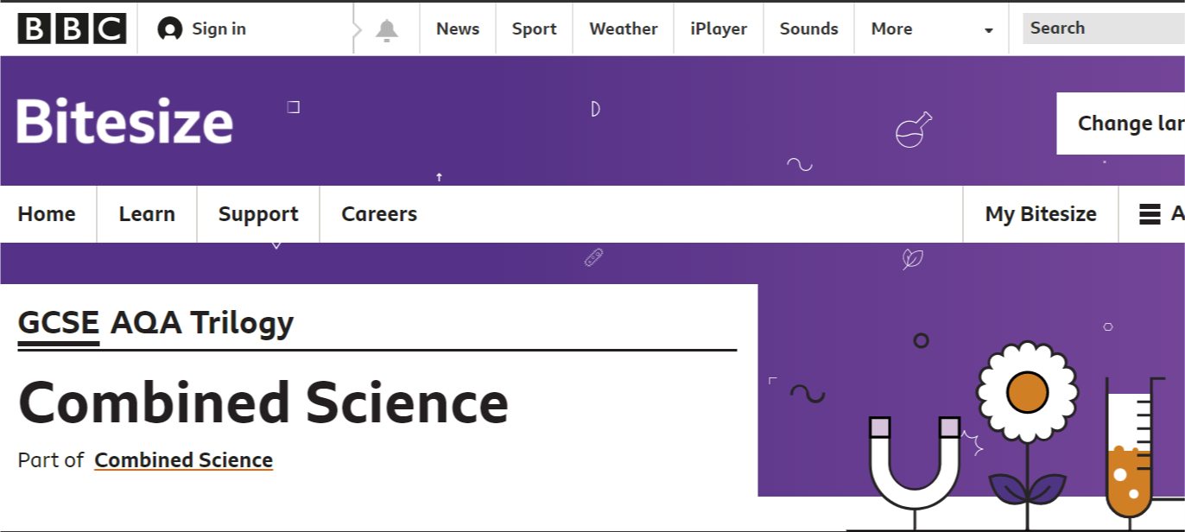
HOW CAN YOU SUPPORT YOUR CHILD?
BBC Bitesize activities, videos and tests Revision guides

Slide 61
HOW CAN YOU SUPPORT YOUR CHILD?
Resources on Highcliffe Science SharePoint
Physics formulae in planner, ionic charges and key terminology for practicals in planner

Slide 62
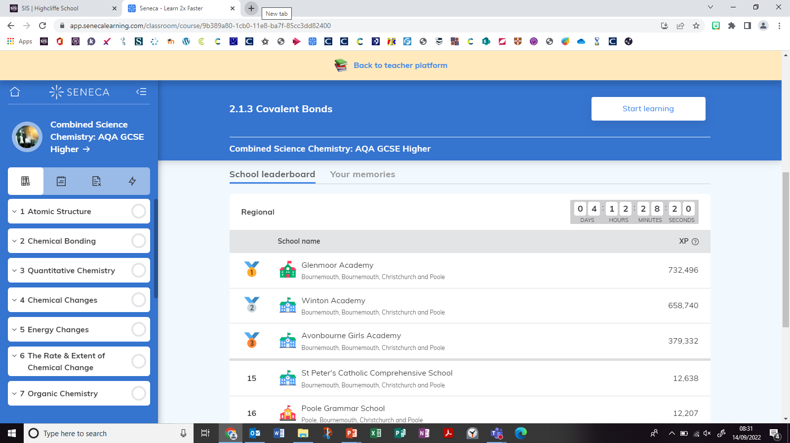
HOW CAN YOU SUPPORT YOUR CHILD?
SENECA Learning

Slide 63
HOW CAN YOU SUPPORT YOUR CHILD?
Reviewing Year 9 and 10 work regularly, to keep on top of content
Using PLC checklists given for each unit to ensure revision is completed and Unit Summary Sheets to check keywords and Required Practicals for each unit
Watch Required Practical videos for revision and make notes (e.g. key apparatus used, variables)
Producing revision resources, not just copying out of a book or reading. Revision needs to be active eg making flash cards of keywords and definitions, answering exam Qs in revision guide to check learning
When testing them, ask them to explain concepts, rather than just recall facts

Slide 64
“
His nature is such that he has to be drawn out by kindness and encouragement but if he be treated well, and love be shown him, he will accomplish things that make the whole world wonder.
Michelangelo, describing himself as a young
art student in 1490AD
”
Year 10 Information Evening Study GCSE Grading System and Progress Checks

Slide 65
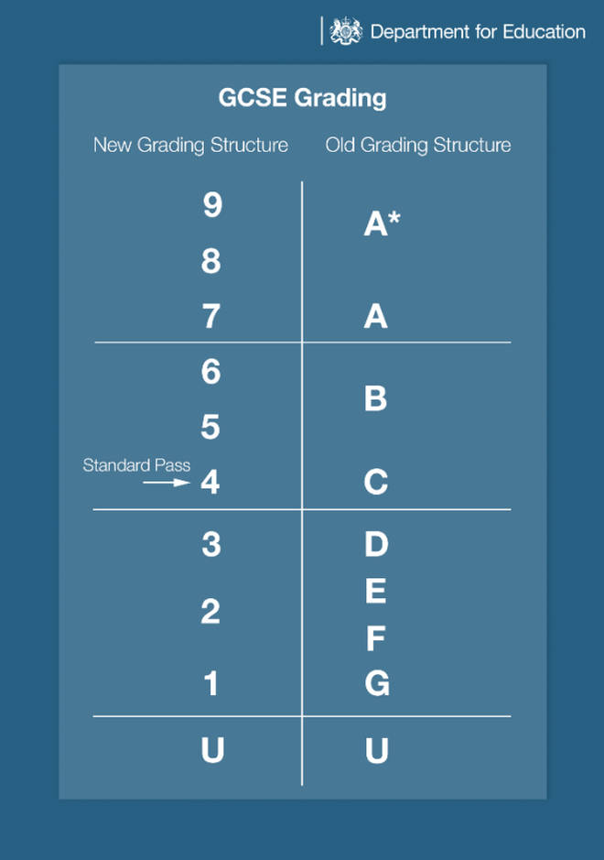
GCSE grades: The 9-1 boundaries explained
The number scale is not directly equivalent to the old letter one. However, the two scales do meet in certain places:
the bottom of grade 7 is aligned with the bottom of grade A
the bottom of grade 4 is aligned with the bottom of grade C
the bottom of grade 1 is aligned with the bottom of grade G
three number grades - 9, 8 and 7 - correspond to the two previous top grades of A* and A

Slide 66
Progress Checks
Sub Grades:
Grades used in our Progress Checks are shown using ‘Sub Grades’ where a ‘.1’ means the student is near to the next higher grade whereas a ‘.3’ means the student is at risk of dropping to the grade below.
As an example, a student receiving a current grade of 4.3 is on the grade boundary between a grade 4 and a grade 3, whereas, a student receiving a current grade of 4.1 is on the grade boundary between a grade 4 and a grade 5.
Attitude to Learning:
Attitude to Learning grades focus closely on a school wide approach to students becoming more independent in their learning. Each student is given an Attitude to Learning rating by the member of staff who takes them for each subject. This is based on observable behaviour that the student displays in class and the quality of the work they produce at home and in school.
Attitude to Learning is assessed on a four-point scale: 1 Dynamic Learner, 2 Active Learner, 3 Passive Learner, 4 Reluctant Learner.
The criteria used for this judgement are detailed at https://www.highcliffe.school/ATLGuidance

Slide 67
“
His nature is such that he has to be drawn out by kindness and encouragement but if he be treated well, and love be shown him, he will accomplish things that make the whole world wonder.
Michelangelo, describing himself as a young
art student in 1490AD
”
Year 10 Information Evening Study Attendance

Slide 68
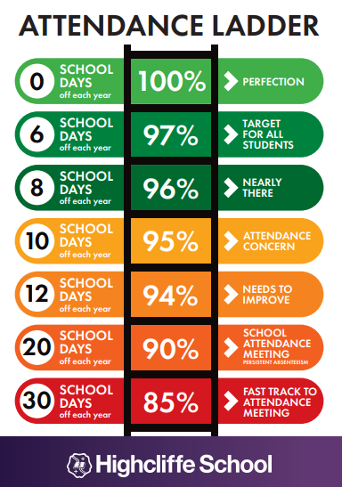
Why is attendance important?
Good attendance is linked to good mental health
It ensures your child has the same opportunities as others
It ensures they don’t miss out on the social side of school and helps maintain friendships
Helps develop good habits for later life
It ensures good educational outcomes
It is the law!

Slide 69
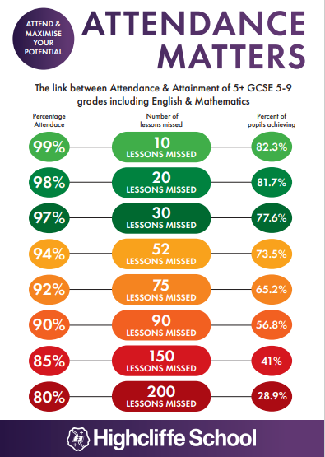
How poor attendance can affect your future.
If your attendance each year is 90% you will have missed 450 lessons over your time in school. At 85% this would be 750 lessons
If you had 100% attendance that would equate to 190 days in school. This still leaves 175 days when your child is not in school which can be used for non urgent appointments
If grades are impacted it will affect your options post 16
Not every student will get grades 5 and above, but every student should have the chance to achieve THEIR potential.

